Slide 1
COVID-19 Total Cases Prediction on Country-based Multivariable Time Series
Nange Li, DSI Brown University
Oct. 15th 2021
GitHub Repository: https://github.com/7ericany/1030Project/tree/master

Slide 2
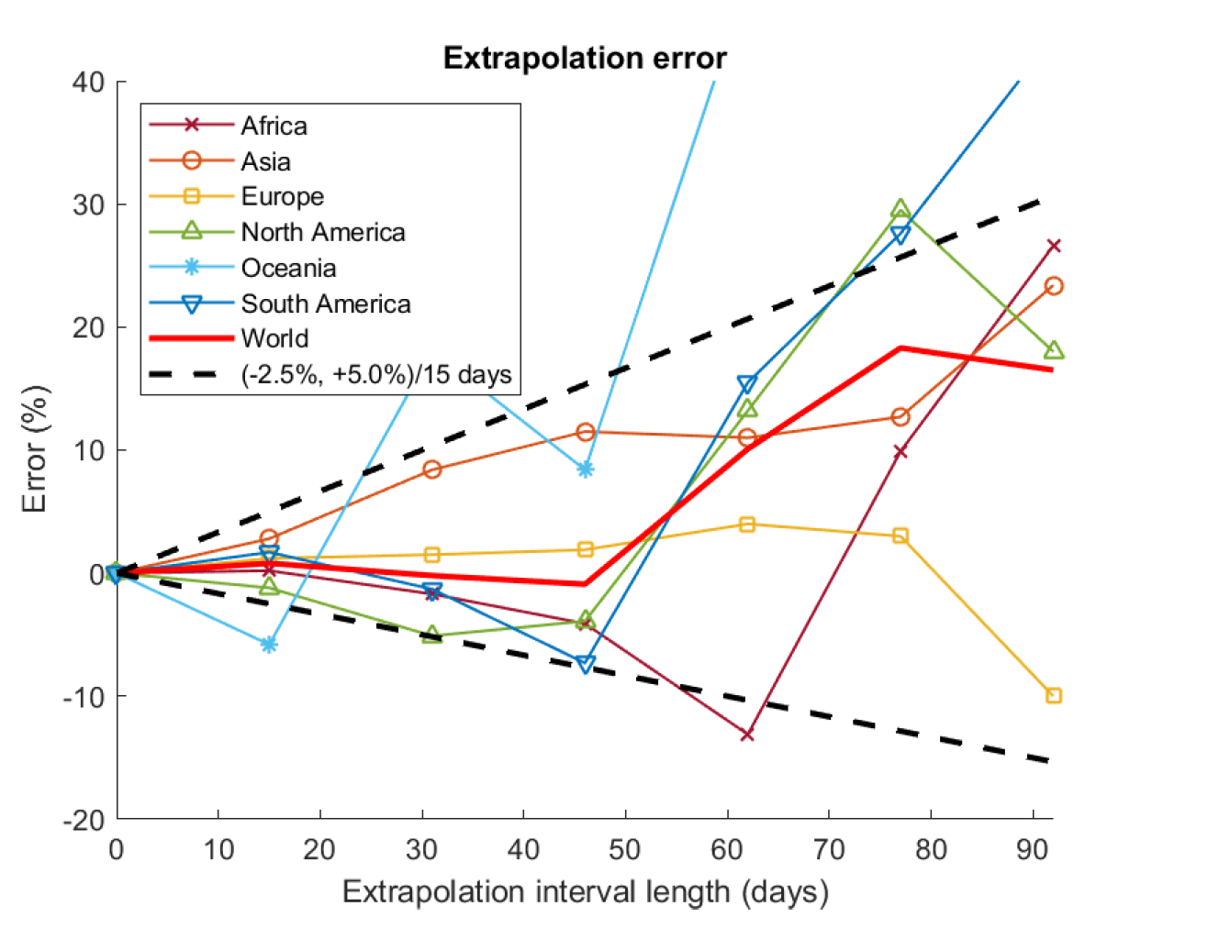
Introduction
COVID-19 Pandemic
Target: total cases
Regression
Dataset
OWID^{[1]} (Our World in Data)
Previous works
Bimodel distribution^{[2]} – deaths
Cloud Computing & Curve Fitting^{[3]} – new_cases
[1] Ritchie, H., Mathieu, E., et al. 2020. "Coronavirus Pandemic (COVID-19)". Published online at OurWorldInData.org. Retrieved from: https://ourworldindata.org/coronavirus
[2] Valvo, & Paolo S. 2020. “A Bimodal Lognormal Distribution Model for the Prediction of COVID-19 Deaths”. Applied Sciences 10, no. 23: 8500. Doi: https://doi.org/10.3390/app10238500
[3] Tuli, S., Tuli, R., Gil, S S., 2020. “Predicting the growth and trend of COVID-19 pandemic using machine learning and cloud computing”. Internet of Things, Volume 11, 2020, 100222, ISSN 2542-6605, Doi: https://doi.org/10.1016/j.iot.2020.100222

Slide 3
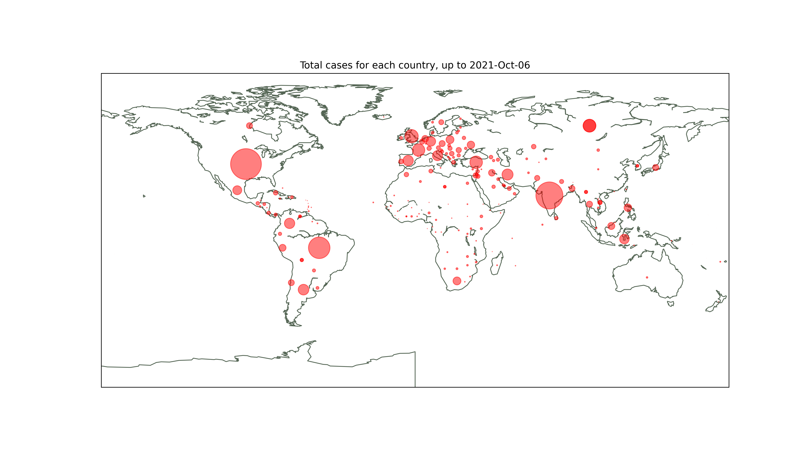
EDA
65 columns
122636 records
233 countries
2020-02-24 to 2021-10-06

Slide 4
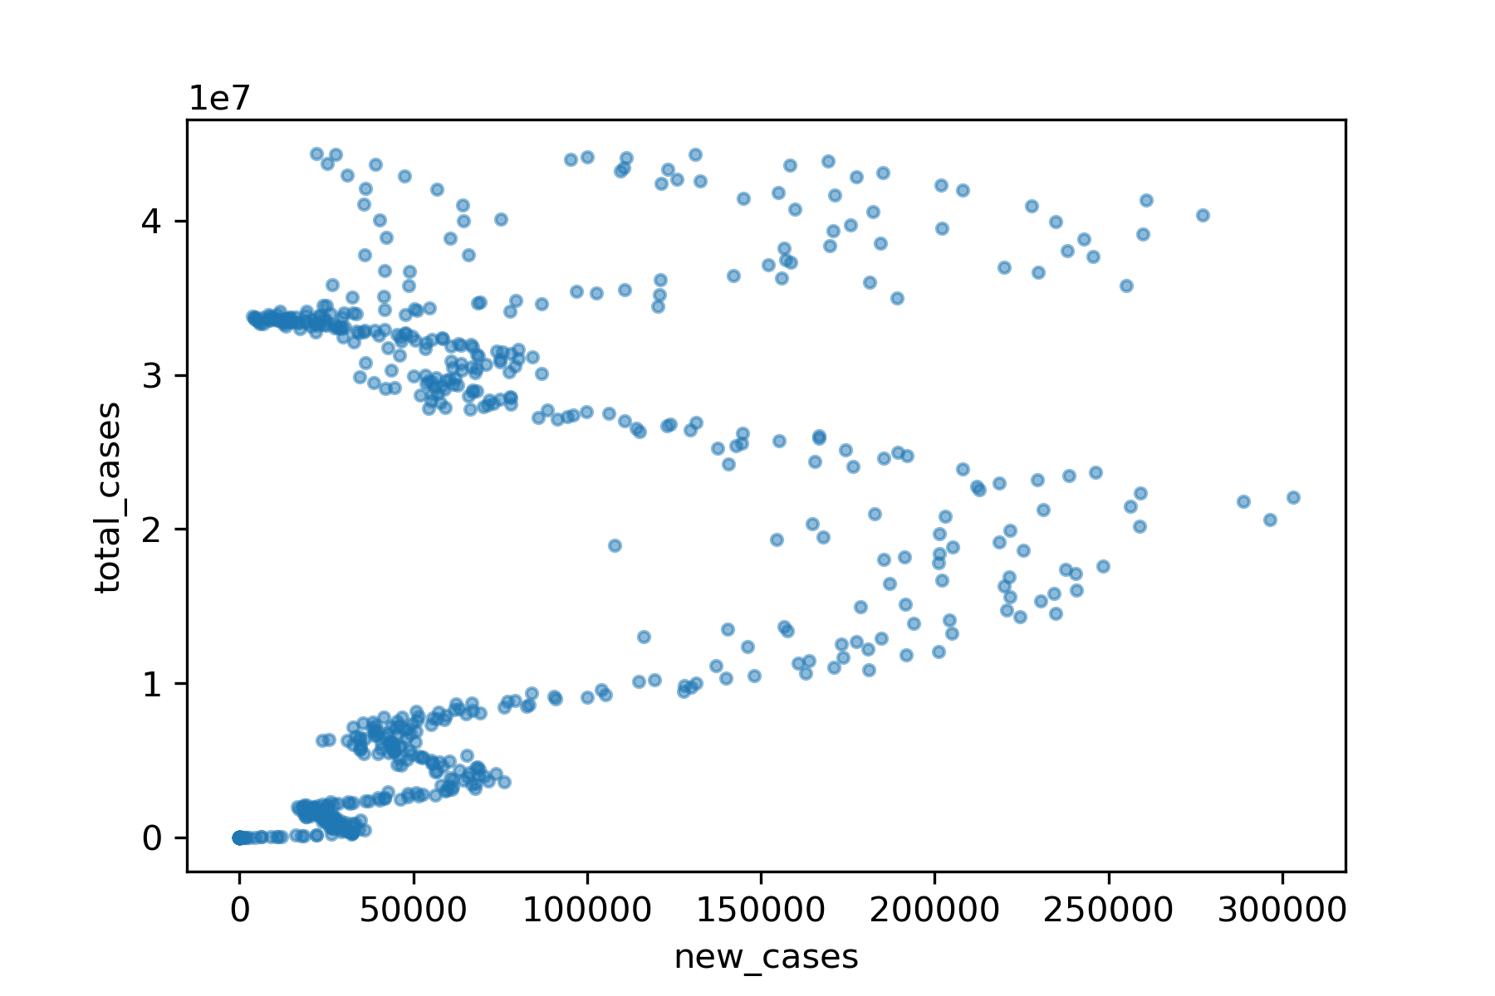
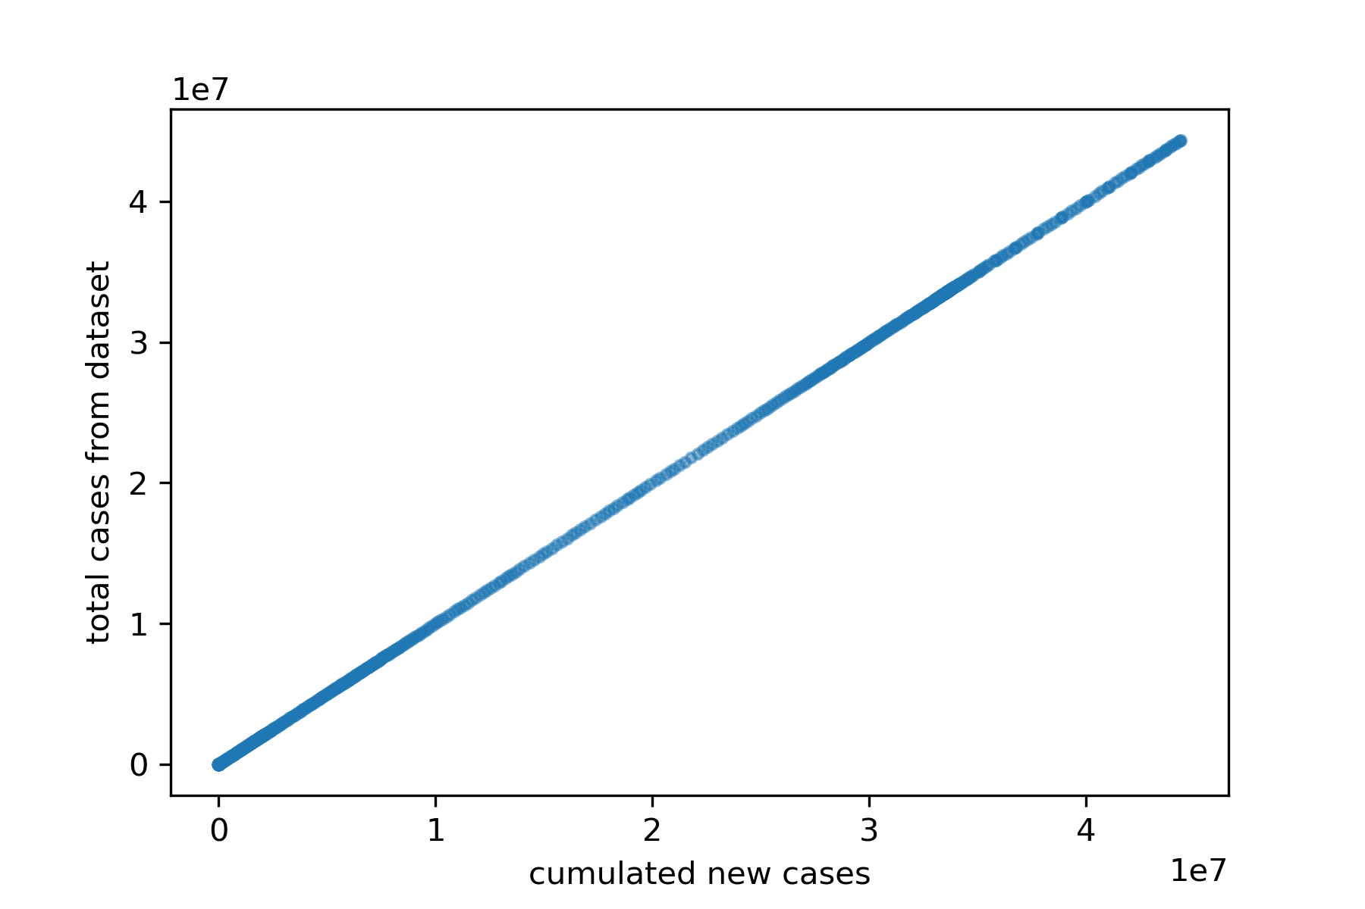
EDA
Some columns cannot be directedly applied to prediction
Country indices, date
Columns regarding new_cases

Slide 5
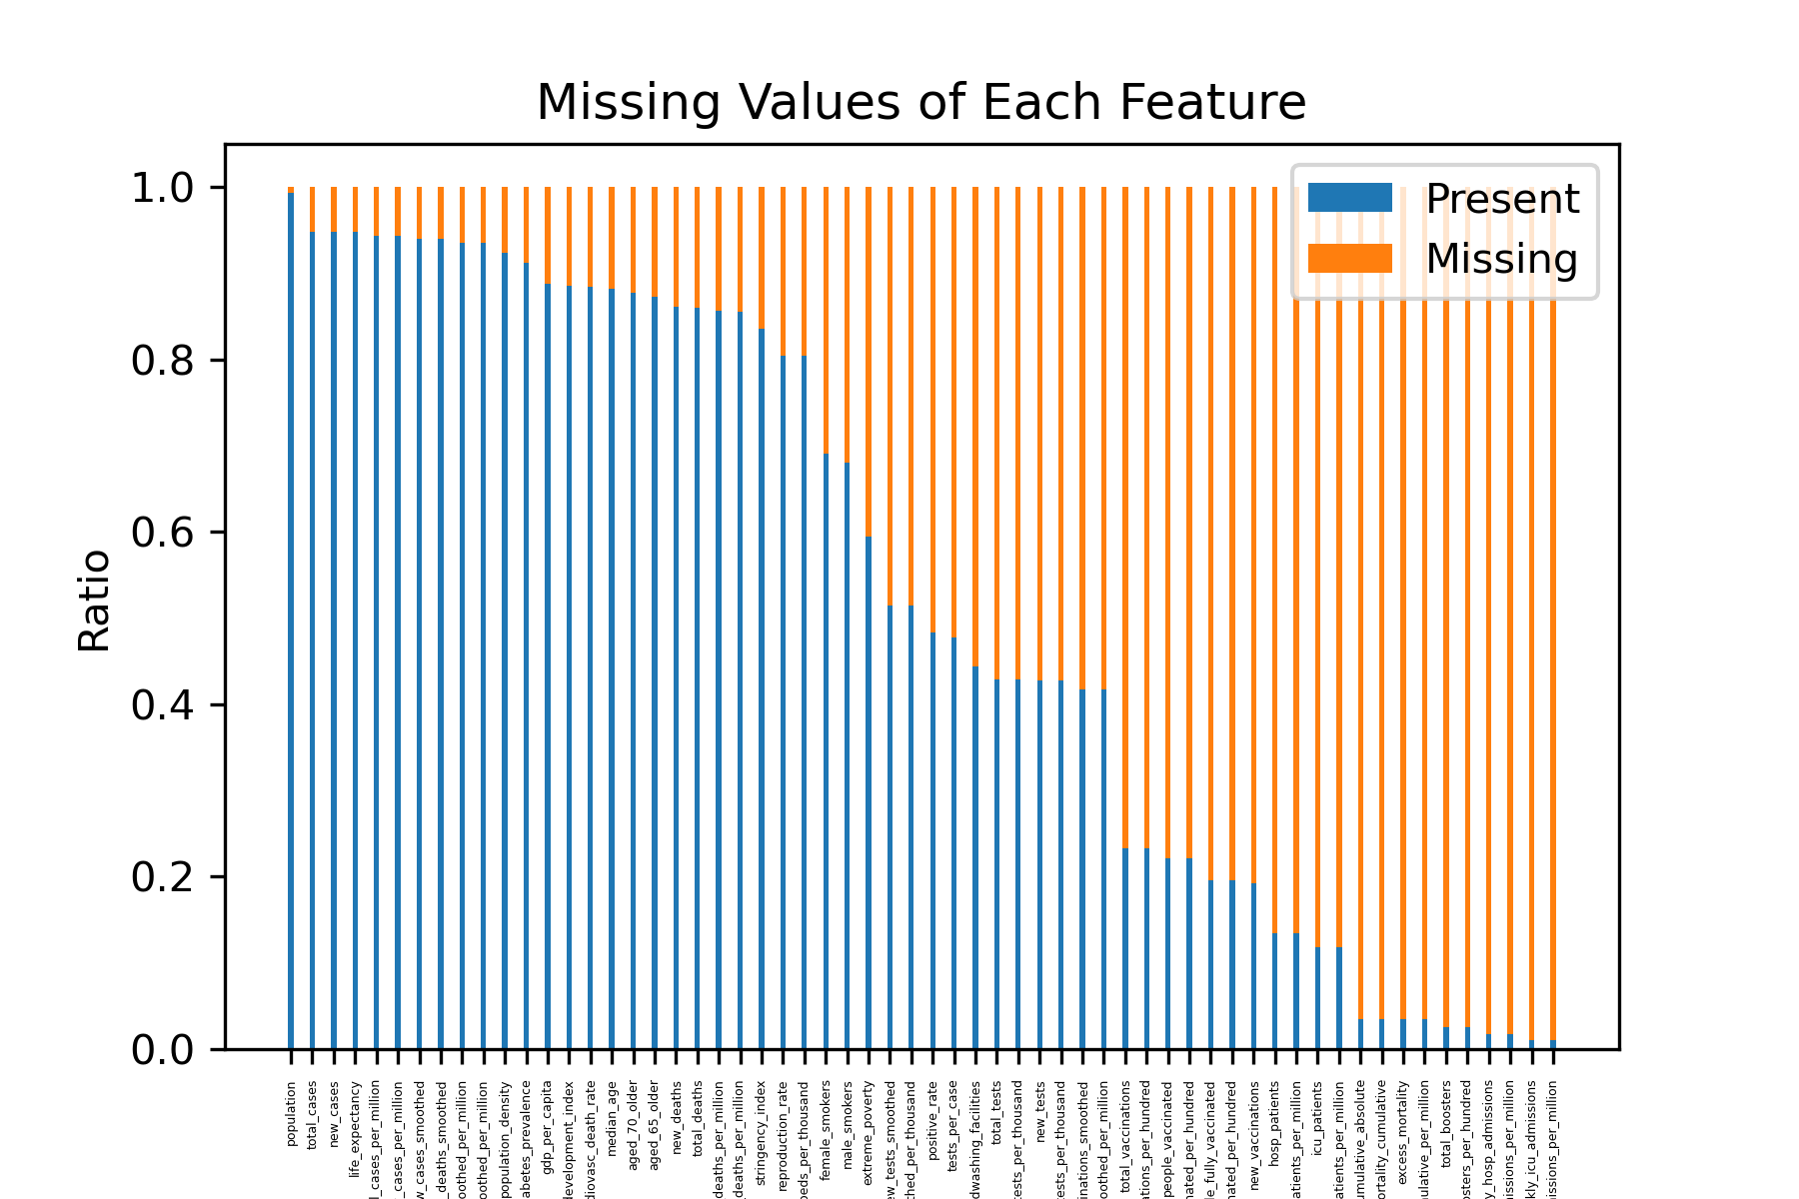
EDA
54 features are selected
19 features – almost 80% missed

Slide 6
EDA
Country 1, 21-06-2021
Country 1, 21-06-2021
Country 1, 22-06-2021
Country 1, 22-06-2021
Country 1, 23-06-2021
Country 1, 23-06-2021
Country 2, 21-06-2021
Country 2, 21-06-2021
Country 1, 21-06-2021
Country 2, 22-06-2021
Country 1, 22-06-2021
Country 2, 22-06-2021
Country 1, 23-06-2021
Country 2, 23-06-2021
Country 2, 23-06-2021
Country 1, 24-06-2021
Country 1, 25-06-2021
Country 3, 21-06-2021
Country 1, 26-06-2021
Country 3, 21-06-2021
Country 3, 22-06-2021
Country 3, 22-06-2021
Country 3, 23-06-2021
Country 3, 23-06-2021
Raw Data
Group on country
Time series ordered by date
Notes:
Group structure
Time series

Slide 7
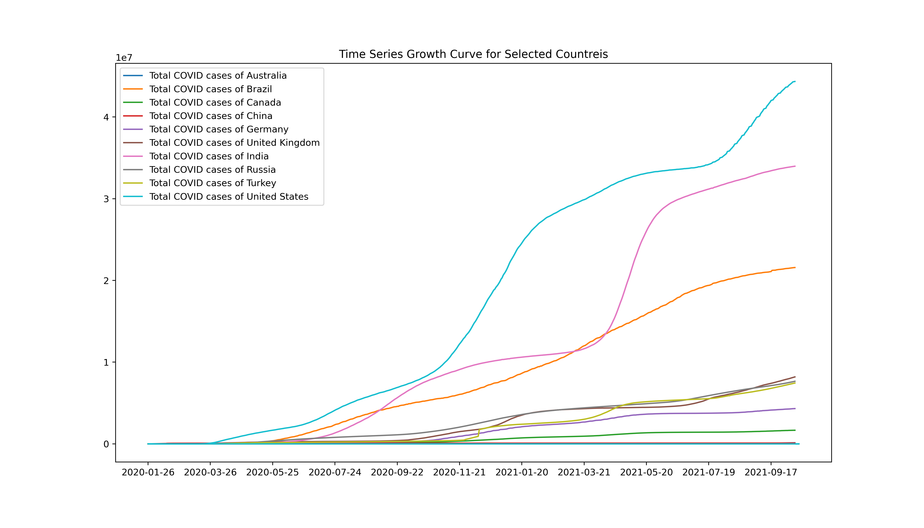
EDA
Data: Time series of different countries

Slide 8
Data Splitting
24-02-2020
24-02-2020
25-02-2020
25-02-2020
.
.
.
.
.
.
.
.
.
.
.
.
.
.
.
.
.
.
.
.
.
.
.
.
.
.
.
.
.
.
.
.
.
.
.
.
KFold Cross-Validation
05-10-2021
05-10-2021
06-10-2021
06-10-2021
Records Test set Training Validation

Slide 9
Preprocessing
Continuous
Some feature types: int
new_tests, aged_65_older, etc.
Standard Scaler
Scaled within KFold splitting
Notes:
Why not categorical

Slide 10
Q&A
Thank you for your listening!

